Slide 1

Note: The data and information in this document is reflective of a hypothetical situation and client. This document is to be used for KPMG Virtual Internship purposes only.
Sprocket Central Pty Ltd
Data analytics approach
[Division Name] - [Engagement Manager], [Senior Consultant], [Junior Consultant]

Slide 2
Note: The data and information in this document is reflective of a hypothetical situation and client. This document is to be used for KPMG Virtual Internship purposes only.
Agenda
Introduction
Data Exploration
Model Development
Interpretation

Slide 3
Note: The data and information in this document is reflective of a hypothetical situation and client. This document is to be used for KPMG Virtual Internship purposes only.
Introduction
Determining features having maximum impact on sales.
Features wil be looking around:
Value
Age group

Slide 4
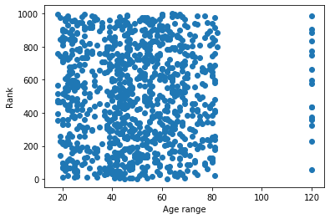
Note: The data and information in this document is reflective of a hypothetical situation and client. This document is to be used for KPMG Virtual Internship purposes only.
Data Exploration
Impact of age groups
Checking out the variation of value against various age groups.
No age range can be removed increase accuracy.

Slide 5
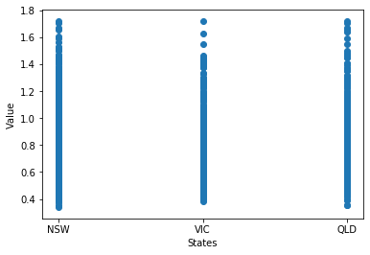
Sorting customers state-wise
Note: The data and information in this document is reflective of a hypothetical situation and client. This document is to be used for KPMG Virtual Internship purposes only.
Data Exploration
It is found that customers from NSW has better rank, followed by QLD.

Slide 6
Note: The data and information in this document is reflective of a hypothetical situation and client. This document is to be used for KPMG Virtual Internship purposes only.
Model Development
Applying regression with 'value' as dependent variable.
Visualizing the data against 'value'
Polynomial regression
R-squared and MSE for analysis

Slide 7
Note: The data and information in this document is reflective of a hypothetical situation and client. This document is to be used for KPMG Virtual Internship purposes only.
Interpretation
Model selection
Grid Search - checking for different hyperparameters ranges.
Conclusion

Slide 8
Note: The data and information in this document is reflective of a hypothetical situation and client. This document is to be used for KPMG Virtual Internship purposes only.
Appendix

